Slide 1

SHOULD WE TALK ABOUT THE
ELEPHANT
IN THE ROOM?
The NC 2020 General Elections
Go Team Blue!

Slide 2

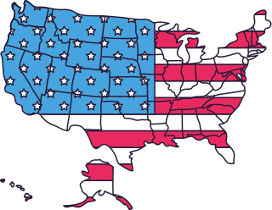

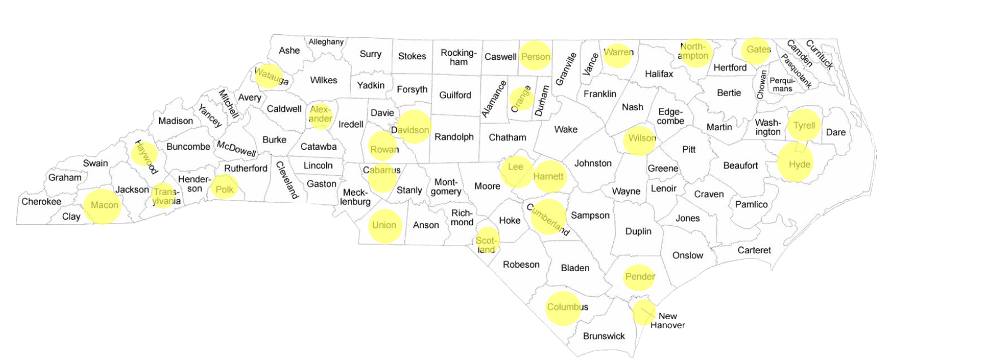

COUNTIES OF INTEREST

Slide 3
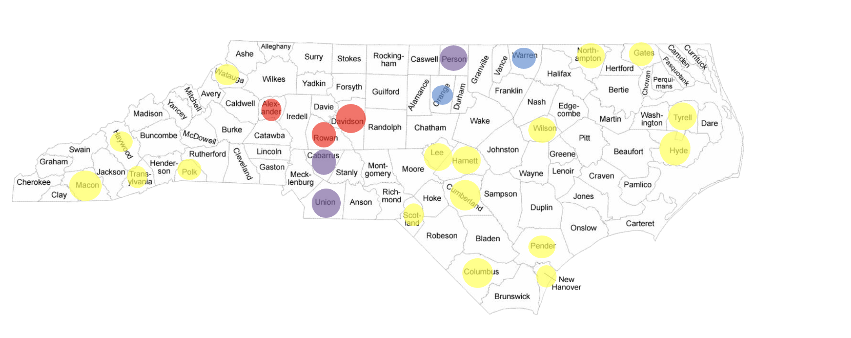
COUNTIES OF INTEREST
*Focus of comparisons is chiefly on DEM and REP, as these are the biggest parties

Slide 4
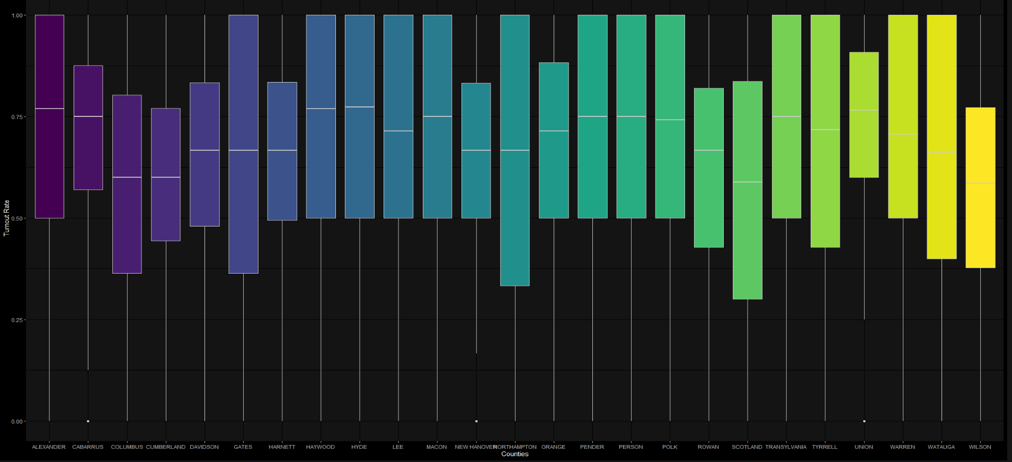


How do different counties vote?

Slide 5
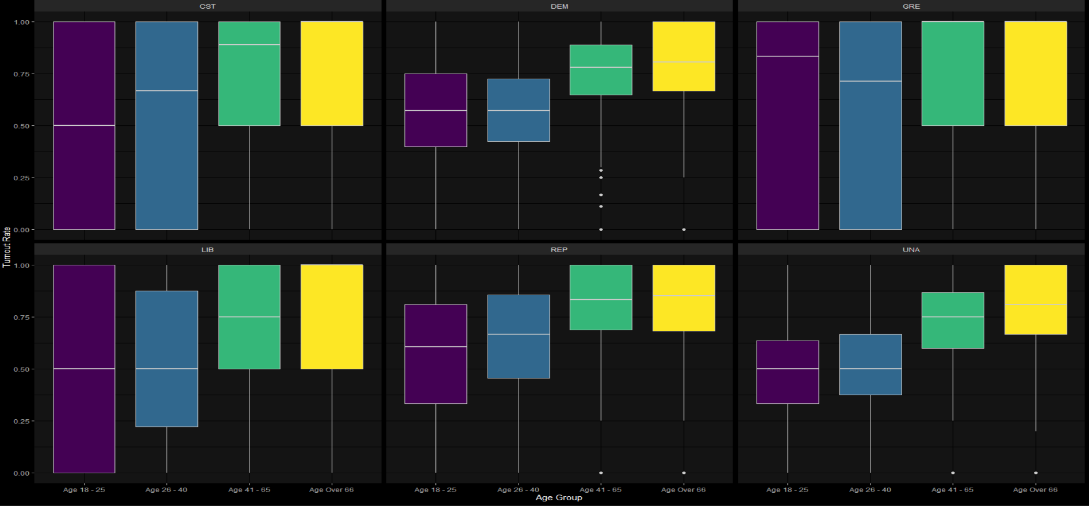
How do different age groups vote?
Let's look at DEM vs REP
The age group 26 - 40 seem to lean towards Republicans

Slide 6
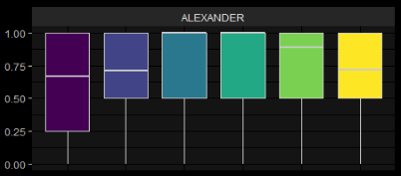
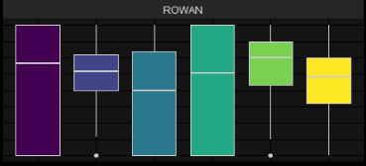
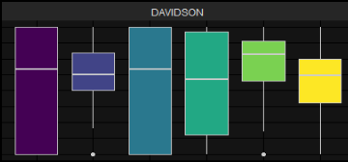
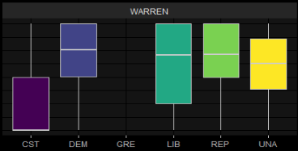
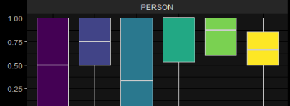
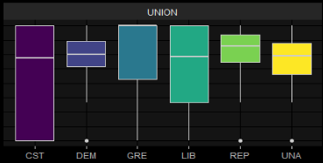
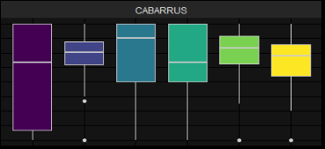
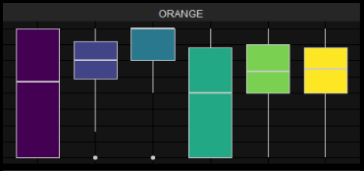
How do different counties vote by party?

Slide 7
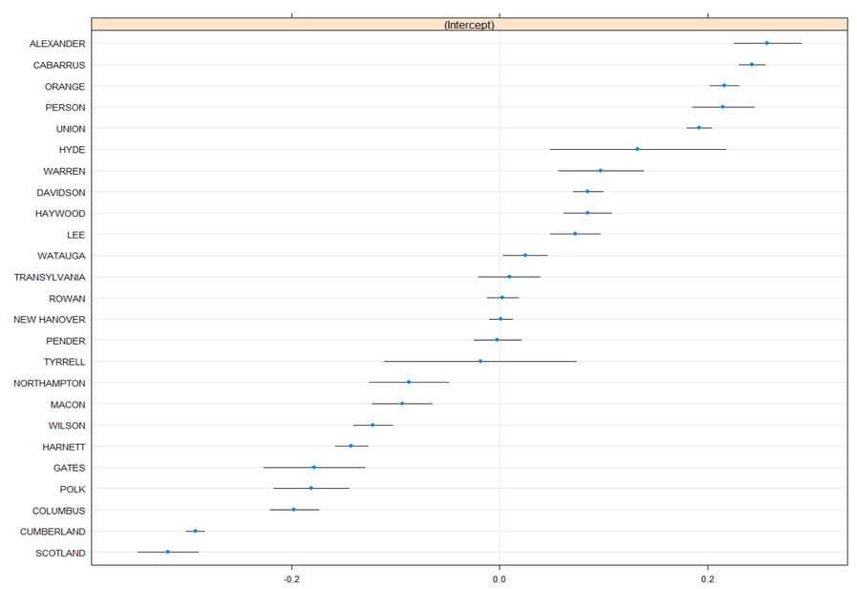
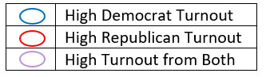
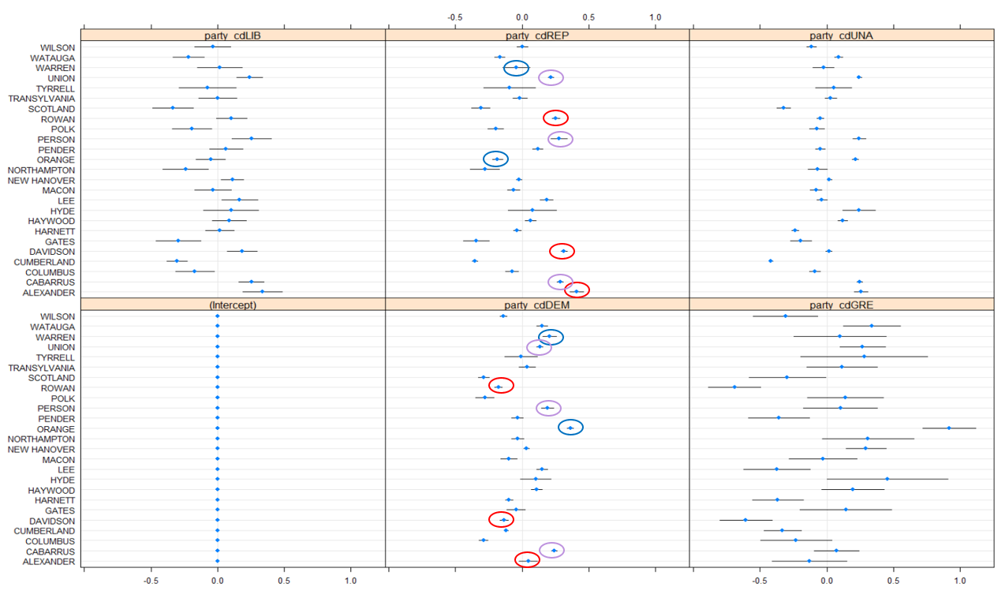
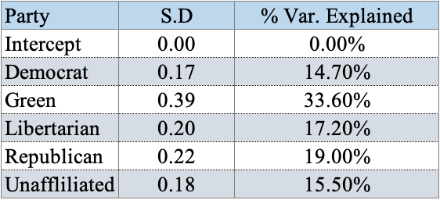
County Turnout Rate
By Party*
*Focus of comparisons is chiefly on DEM and REP, as these are the biggest parties

Slide 8
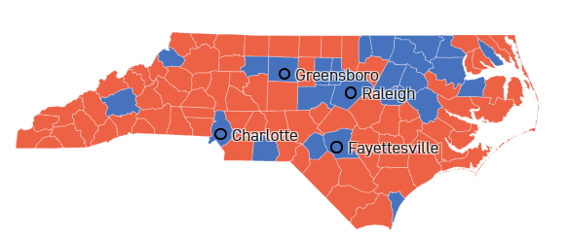
So what actually happened?

Slide 9




Let's look deeper...
Demographics will give us insight as to where Republicans are edging out Democrats
Sex vs. Party
Turns out, this is insignificant.

Slide 10



What about age?
Republicans
Democrats
66+ years old
41-65 year olds
26-40 year olds
Notes:
- rep: claim to have less tax, saving more of what you earned
- dem: claim to provide more social benefit by charging more tax
The young adults/mid-year: tend to be more sensitive to the policies by parties. REP demands fewer taxes, and this voting turnout behavior hence makes sense for this age group.

Slide 11

Voter's age deep dive
odds of turnout
at 26-40 (**)
Democrats
2.05
Republicans
2.41

Slide 12

Merci!
We asked ourselves 876324273 questions so please no more!

